Slide 1

NET
Nursing Evaluation Tool

Slide 2
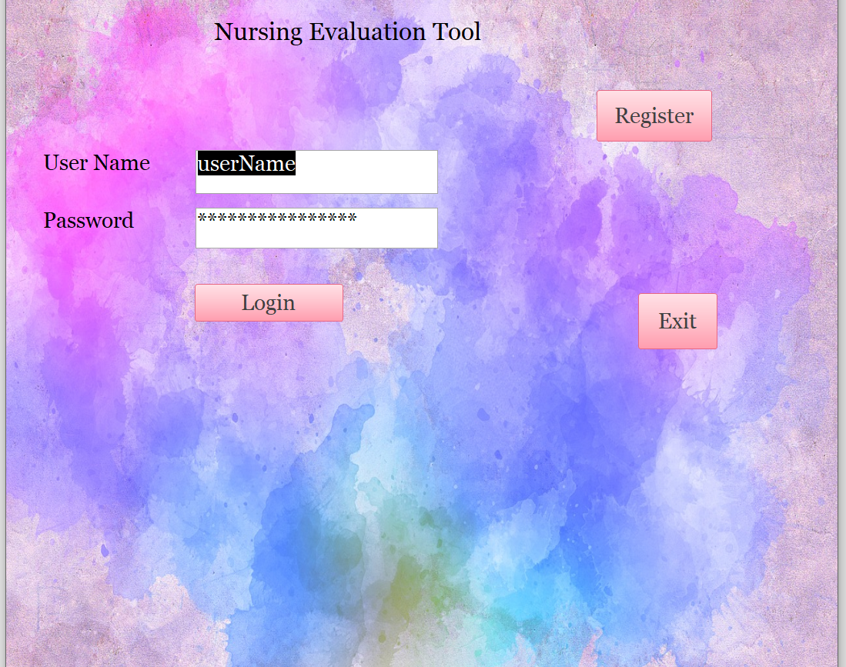
Login Form and registration
MS Office – Access Application
Login and Registration Form written with Visual Basic Code.

Slide 3
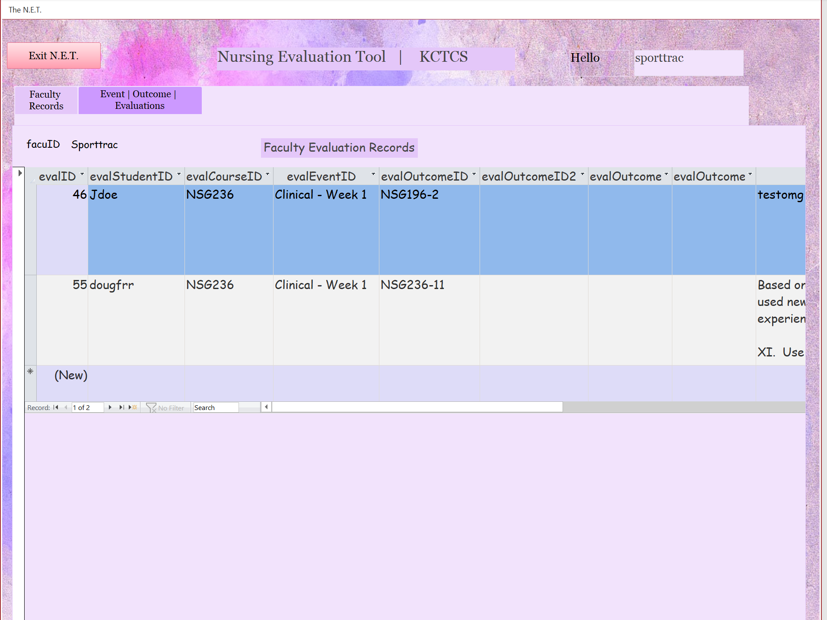
Faculty Records form
Show only records for that faculty. Displays students' outcomes after an event.

Slide 4
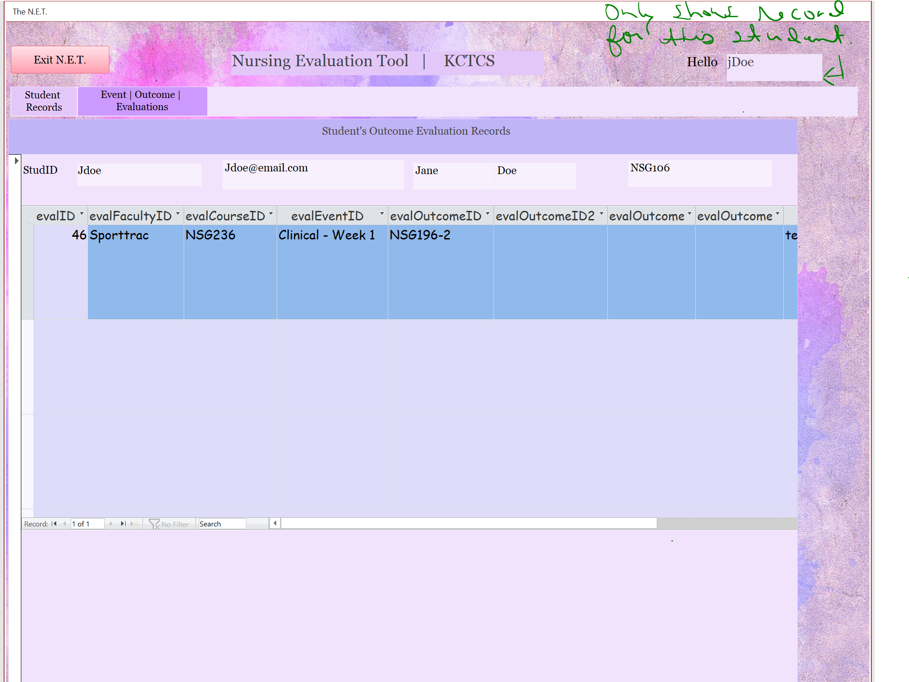
Students Records form
Shows only records for that student. Displays their outcomes from their events, ex: clinical.

Slide 5
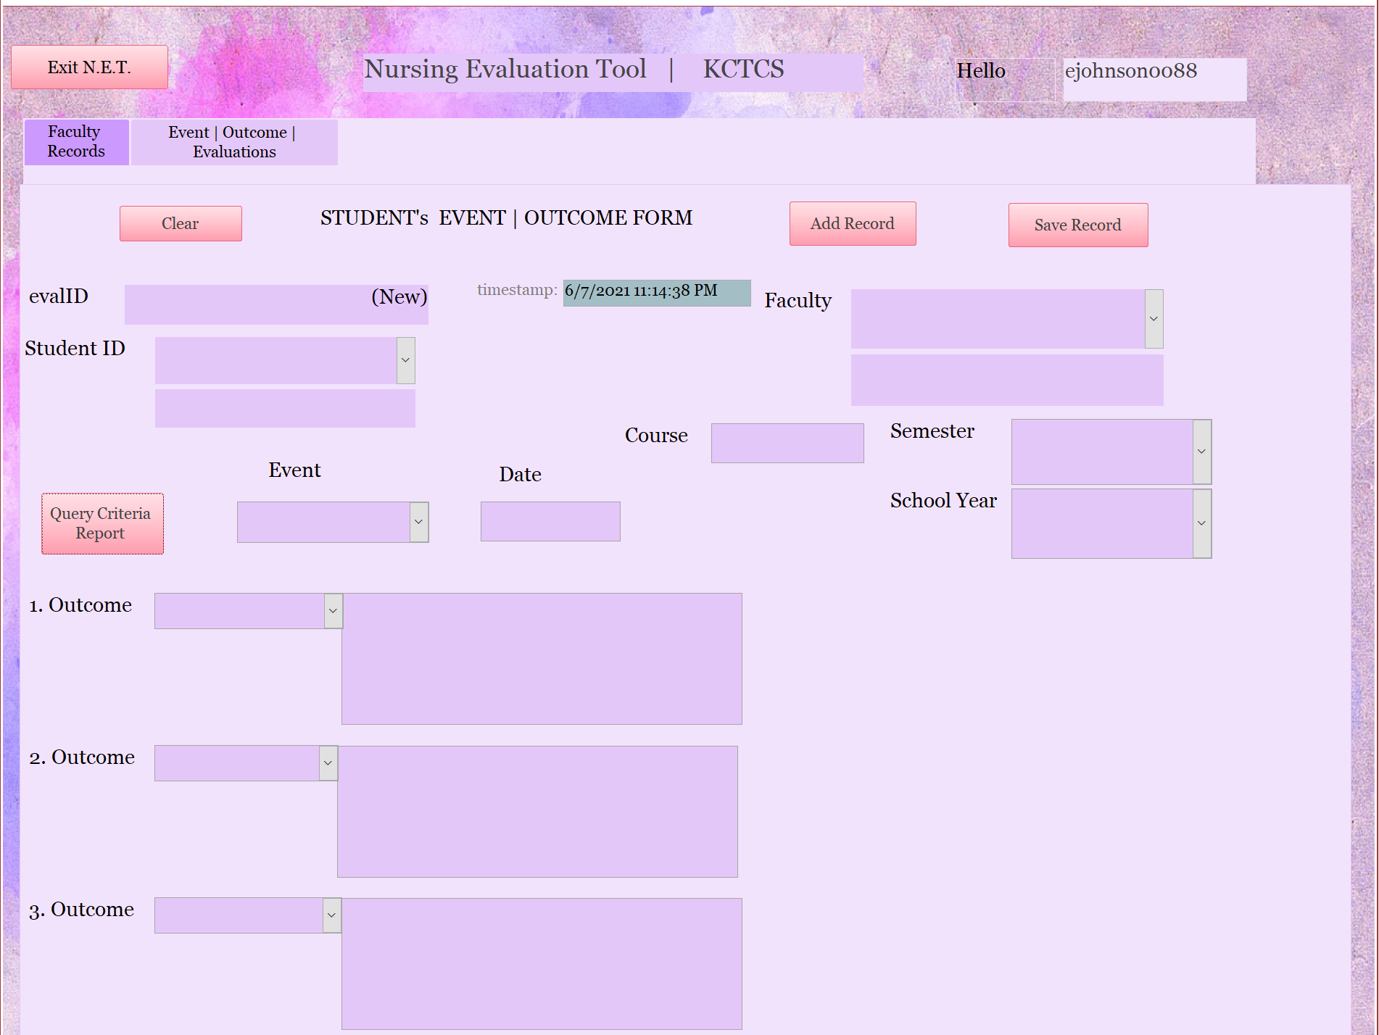
Outcome eval form
STUDENT ENTERS OUTCOME FOR AN EVENT. IF MORE THEN 4 OUTCOMES, IT IS OK TO CREATE ANOTHER RECORD.

Slide 6
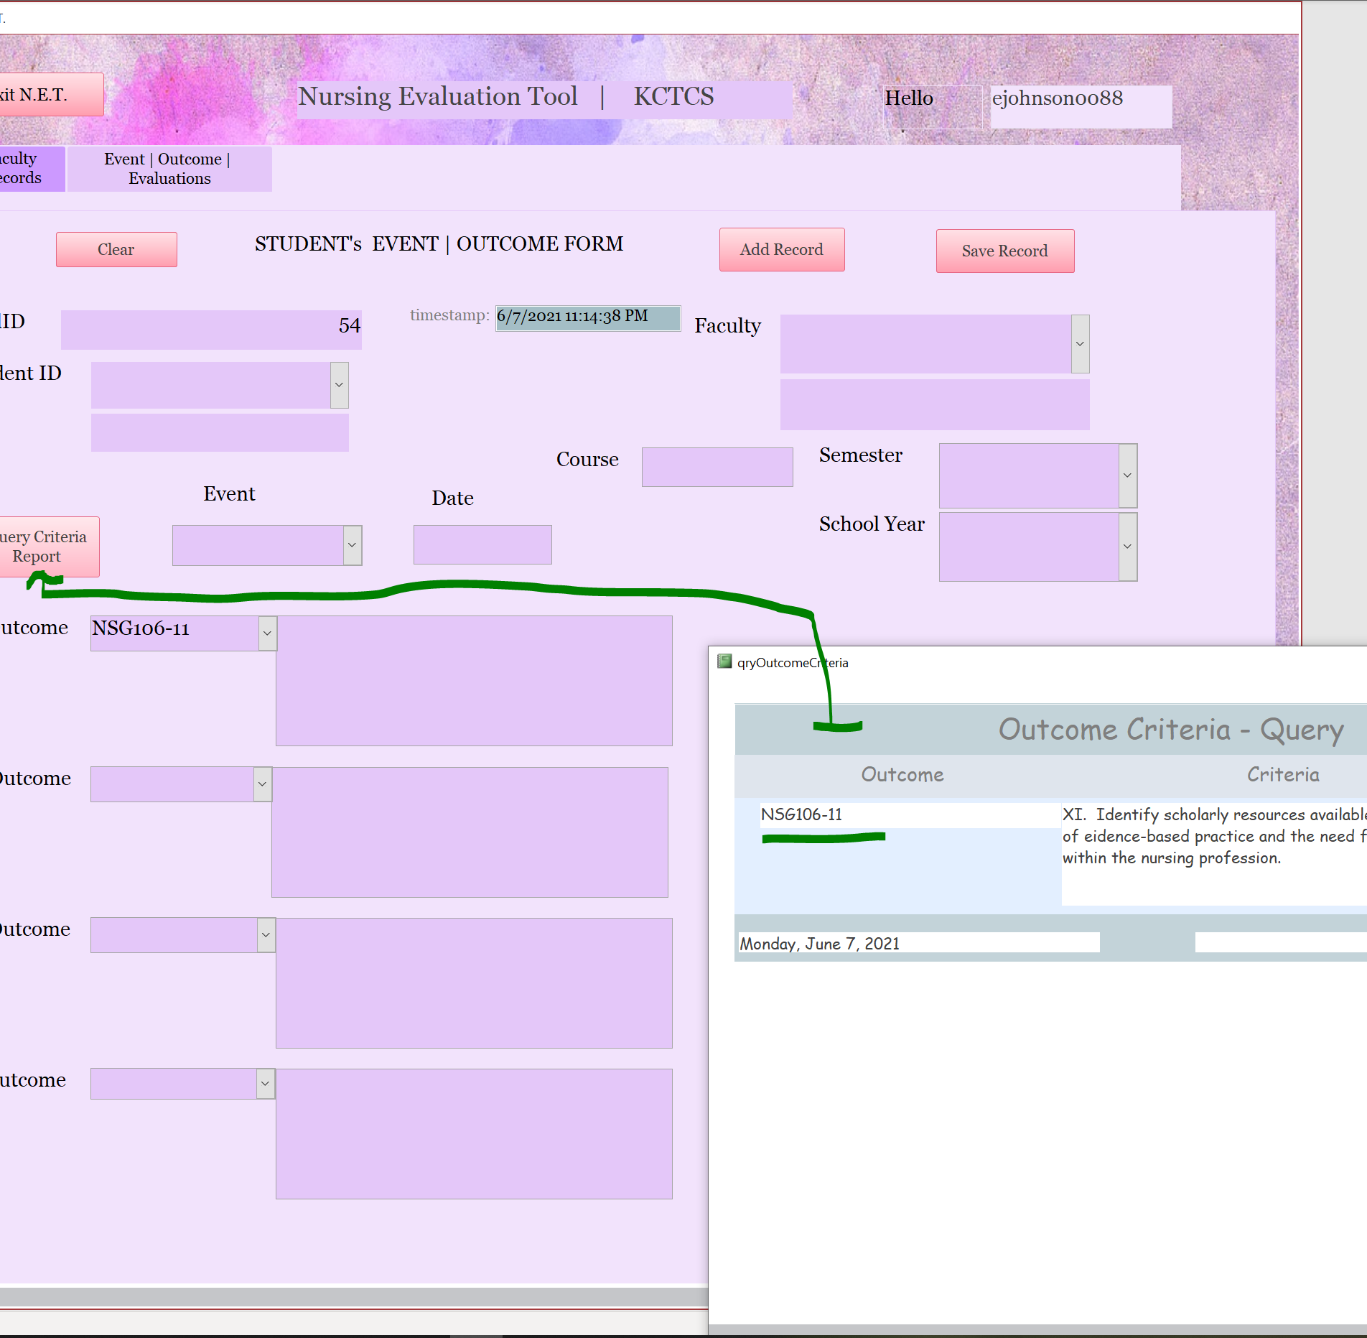
OUTCOME eval form CRITIERIA DETAILS
Outcome criteria queries all outcomes; display them in a dropdown box to choose from.

Slide 7
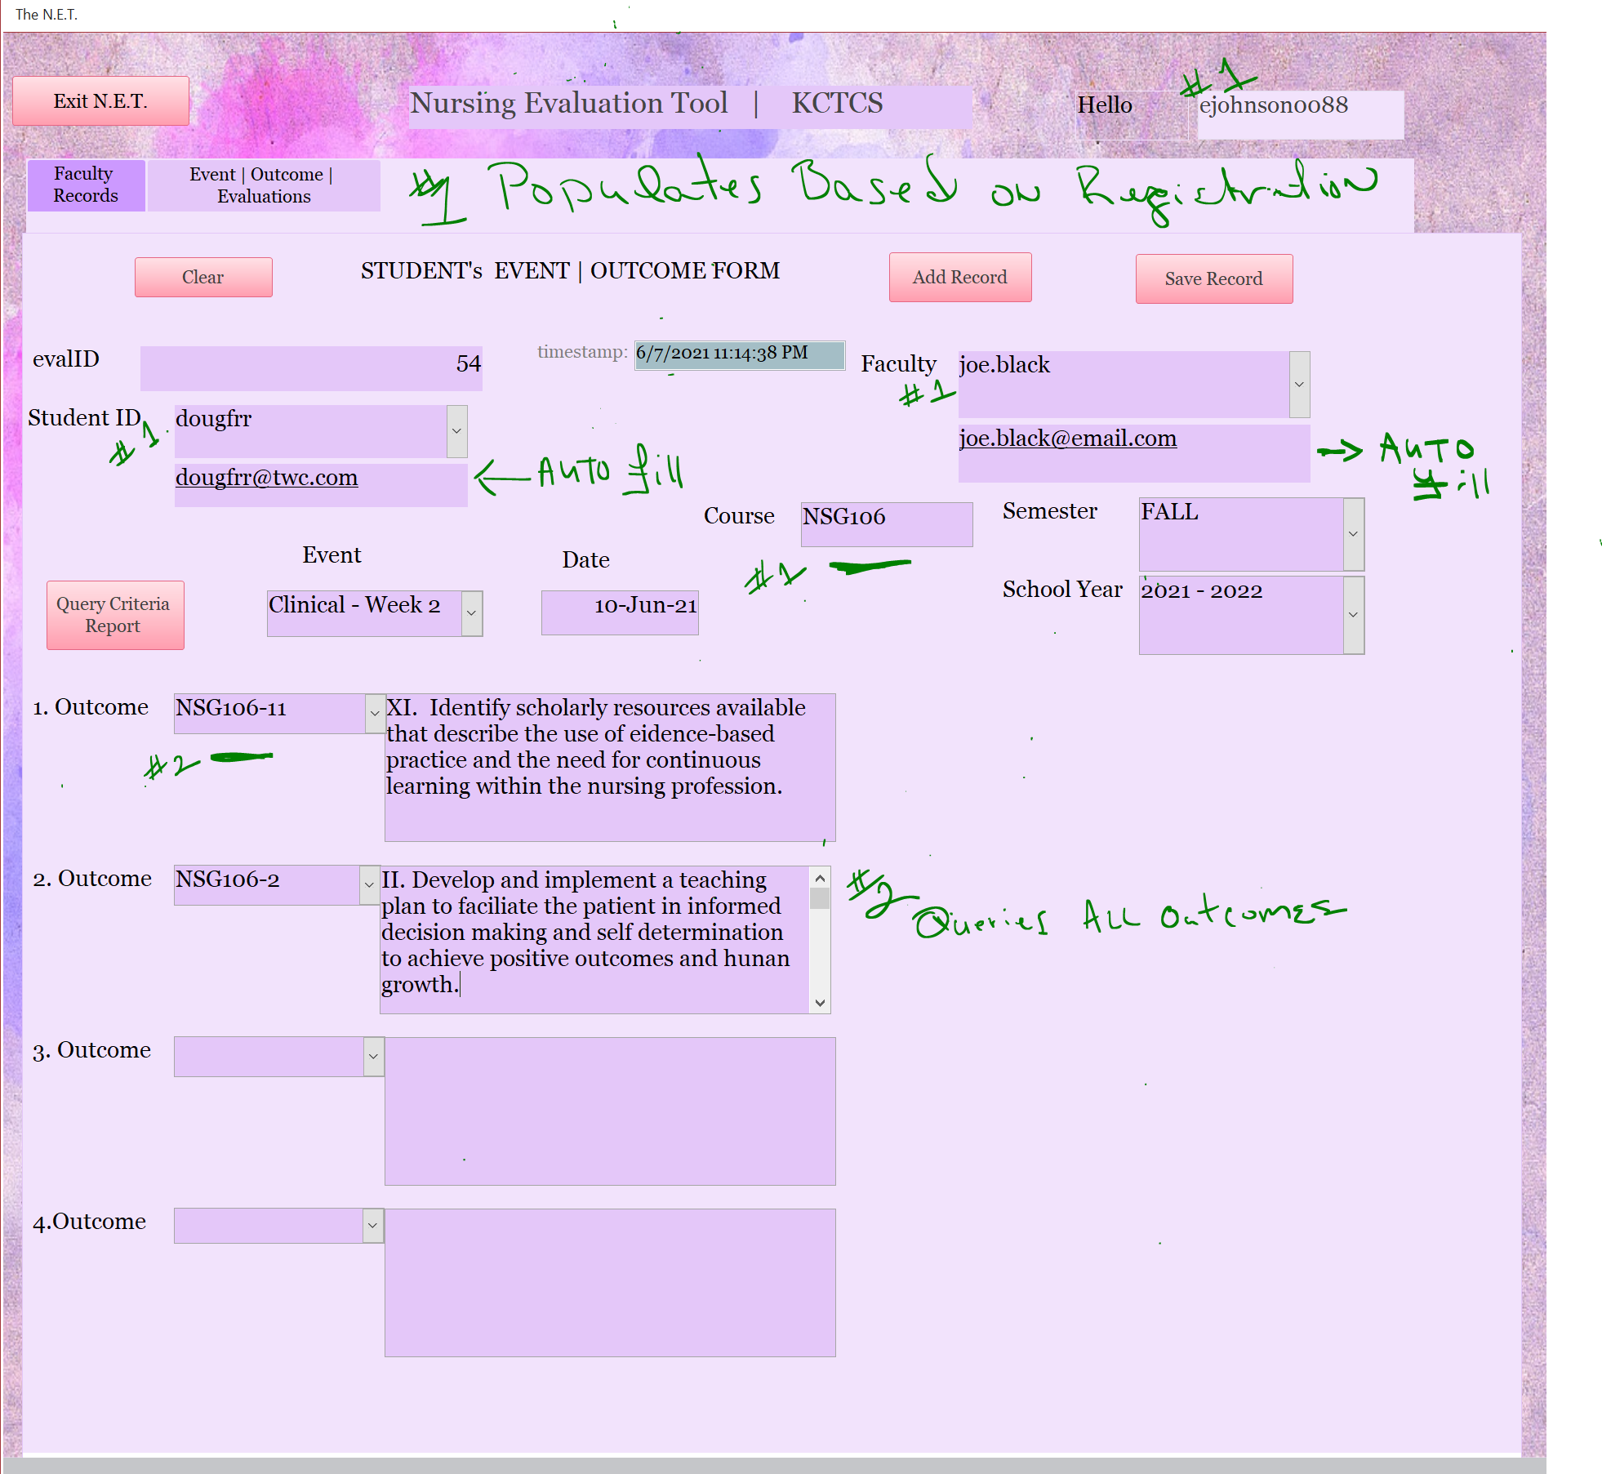
Outcome eval form
Top part of the form shows where data is populated based on user registration.
Outcome text boxes is where a student fills out the outcome for the day based on the criteria set by each course. Ex: NSG106-11

Slide 8
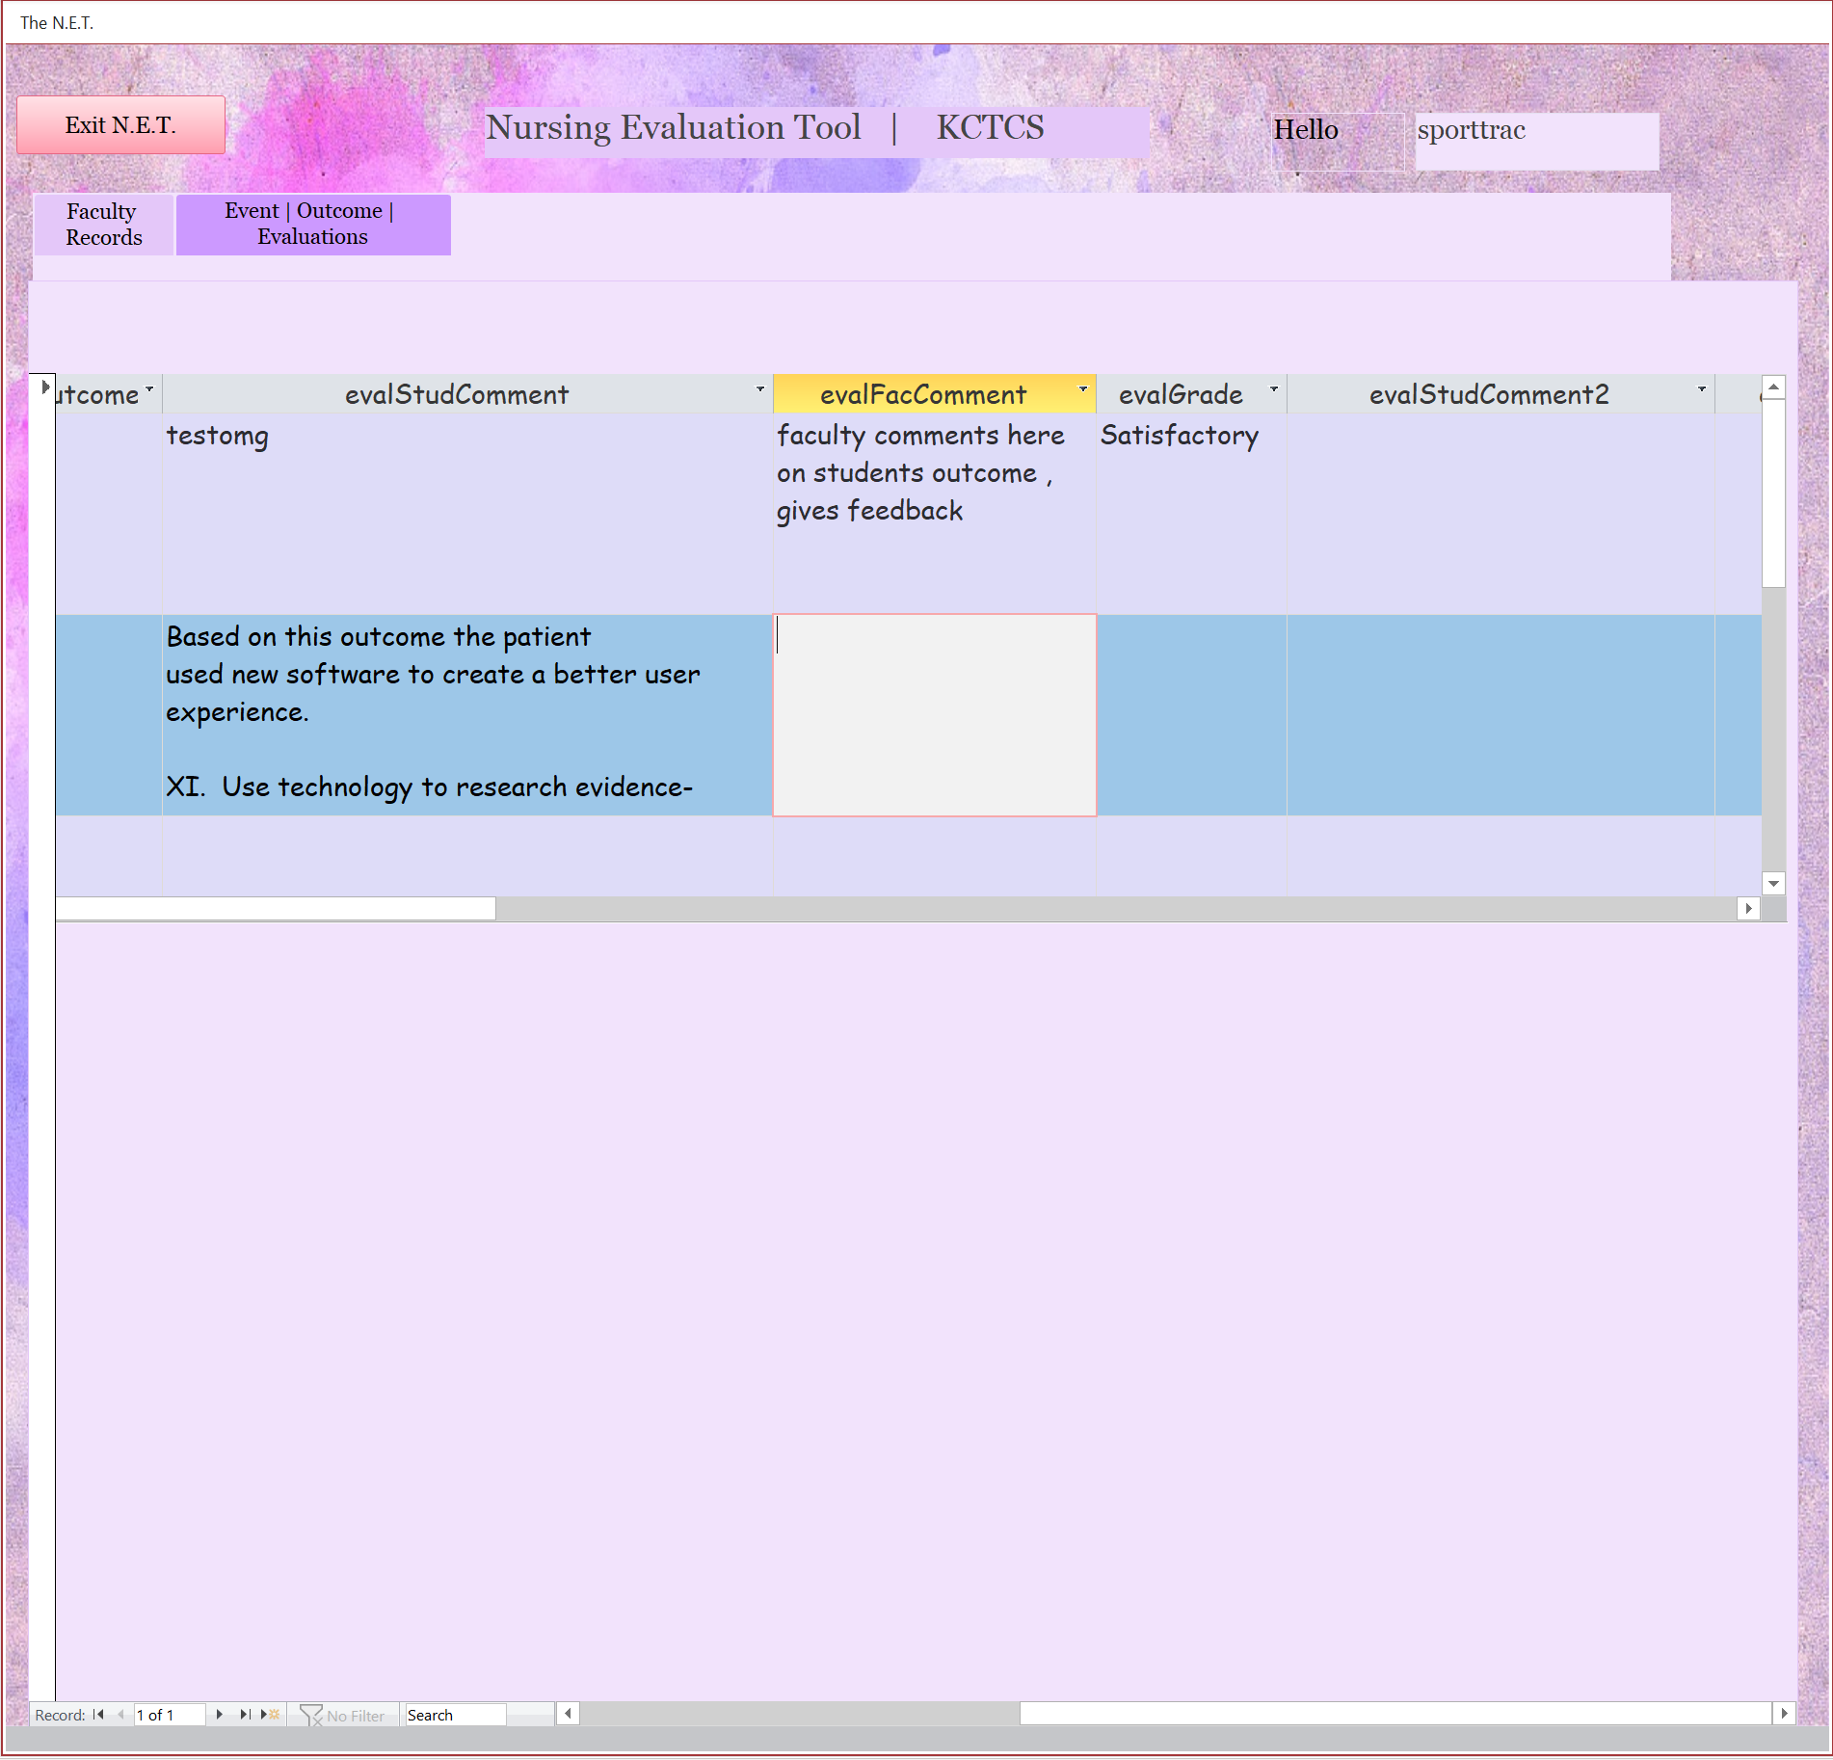
Faculty records enters feedback and grades
Instructor evaluates students' event/clinical outcomes; gives feedback and a grade.

Slide 9
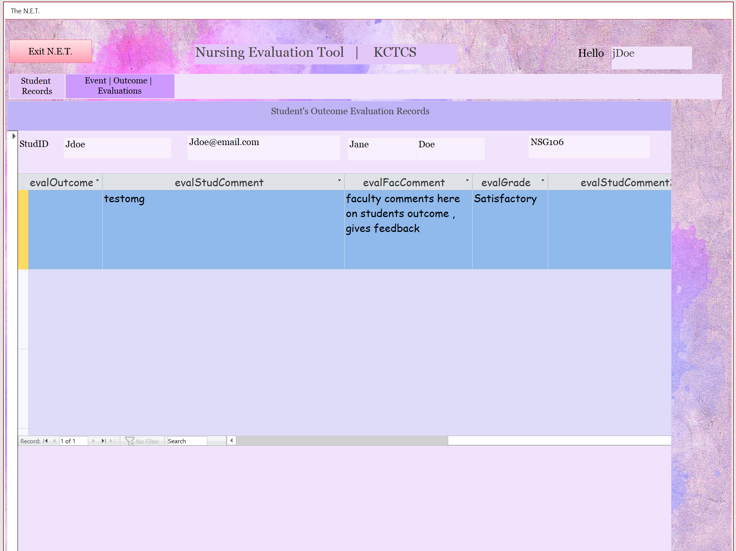
Student record views feedback and grade
Student can view their instructors' feedback and grade for a particular event.

